Slide 1
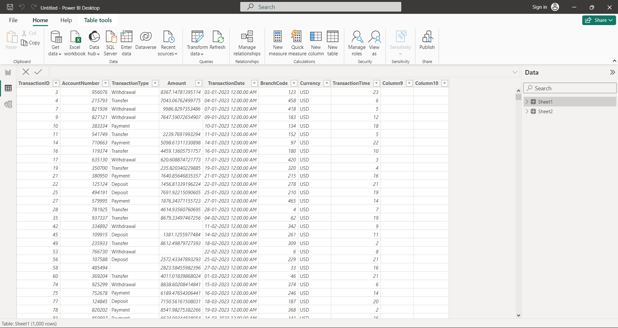
Data Importing and Initial Examination
Process of Importing Data:
• Launched Power Bl and clicked on the 'Get Data' option.
• Chose the 'Excel' option and located the 'BankingDataset1.xlsx' and 'BankingDataset2.xlsx'
files.
• Selected these files for import, ensuring to keep the default import settings.
Initial Examination of Datasets:
• Carefully reviewed the column names to ensure they matched the descriptions provided.
• Checked the data types of each column to confirm they were appropriate.
• Examined the first few rows of data to understand the data's format and potential issues.
Identification of Data Quality Issues:
• Noticed several missing values in the 'Amount' column of the 'Banking Transactions' dataset.
• Observed some duplicate entries in the 'TransactionlD' column.
• Identified outliers in the 'Balance' column of the 'Customer Account Details' dataset.
• Recognized the need for thorough data cleaning and validation before proceeding with the
analysis.

Slide 2
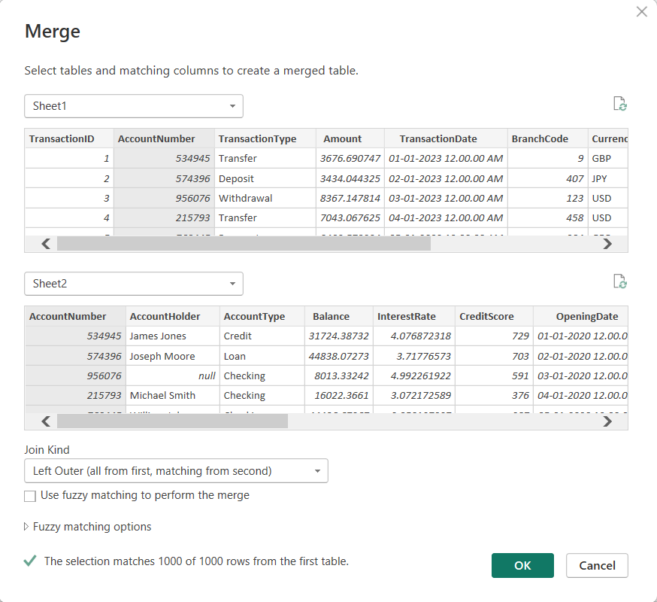
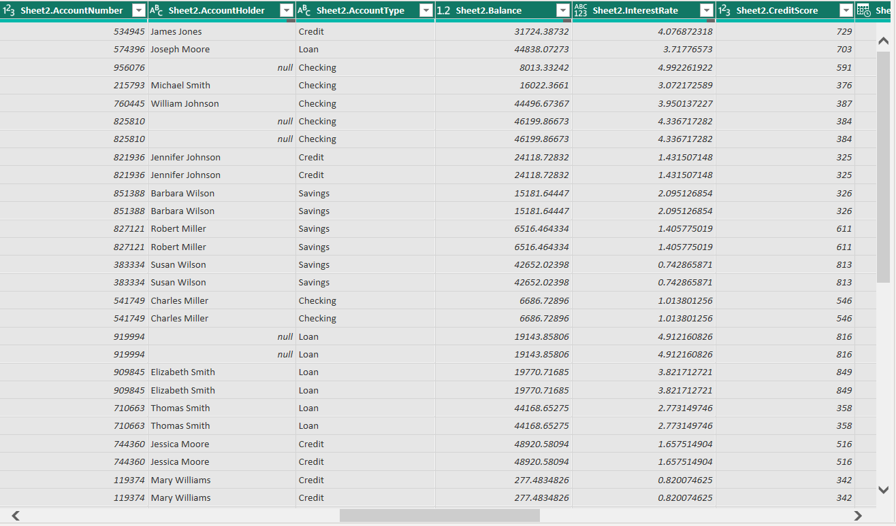
Merging and Relating Datasets
Merging Process:
• Used the 'AccountNumber' column as the key to merge the datasets.
• Linked each transaction in the 'Banking Transactions’ dataset with corresponding account details from the 'Customer Account Details' dataset.
• Ensured accuracy to avoid loss of information.
• Encountered discrepancies in data formatting, especially with date columns.
• Standardized date formats before merging.
Retaining Necessary Information:
• Verified retention of all relevant information from both datasets in the merged dataset.
Accuracy and Completeness:
• Ensured accuracy and completeness were paramount.
• Validated the merged dataset by comparing total records before and after the merge.
• Cross-referenced key data points to confirm consistency between original datasets and the merged dataset.

Slide 3
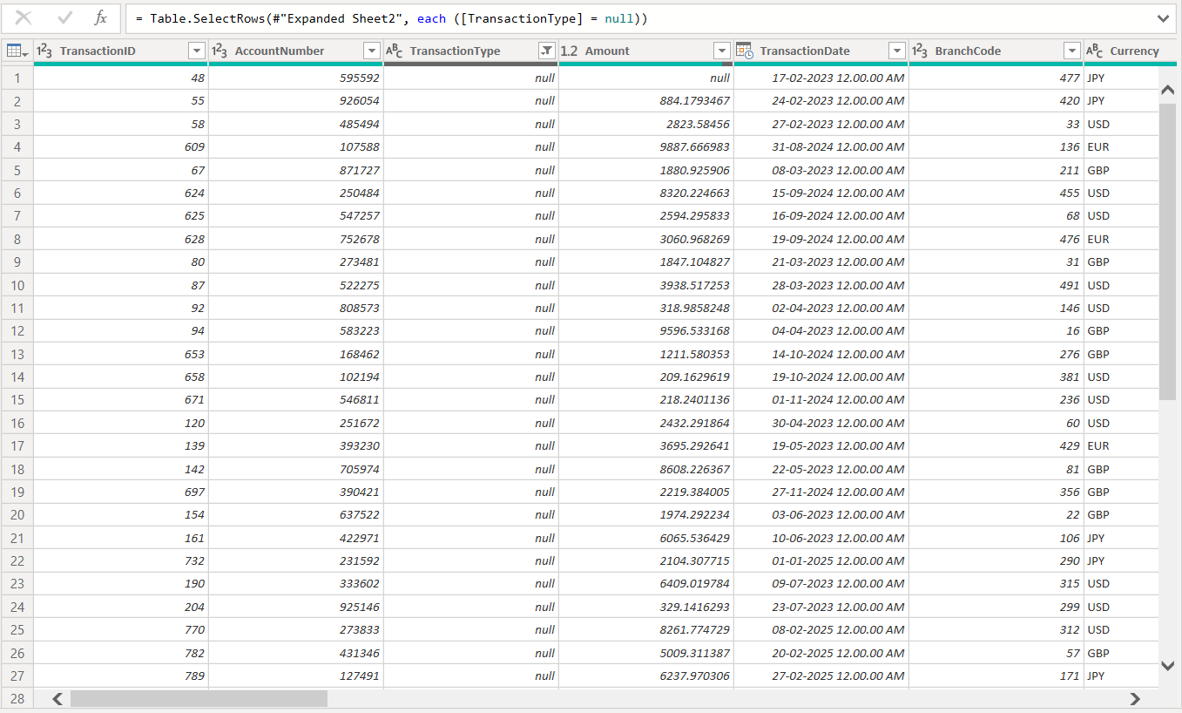
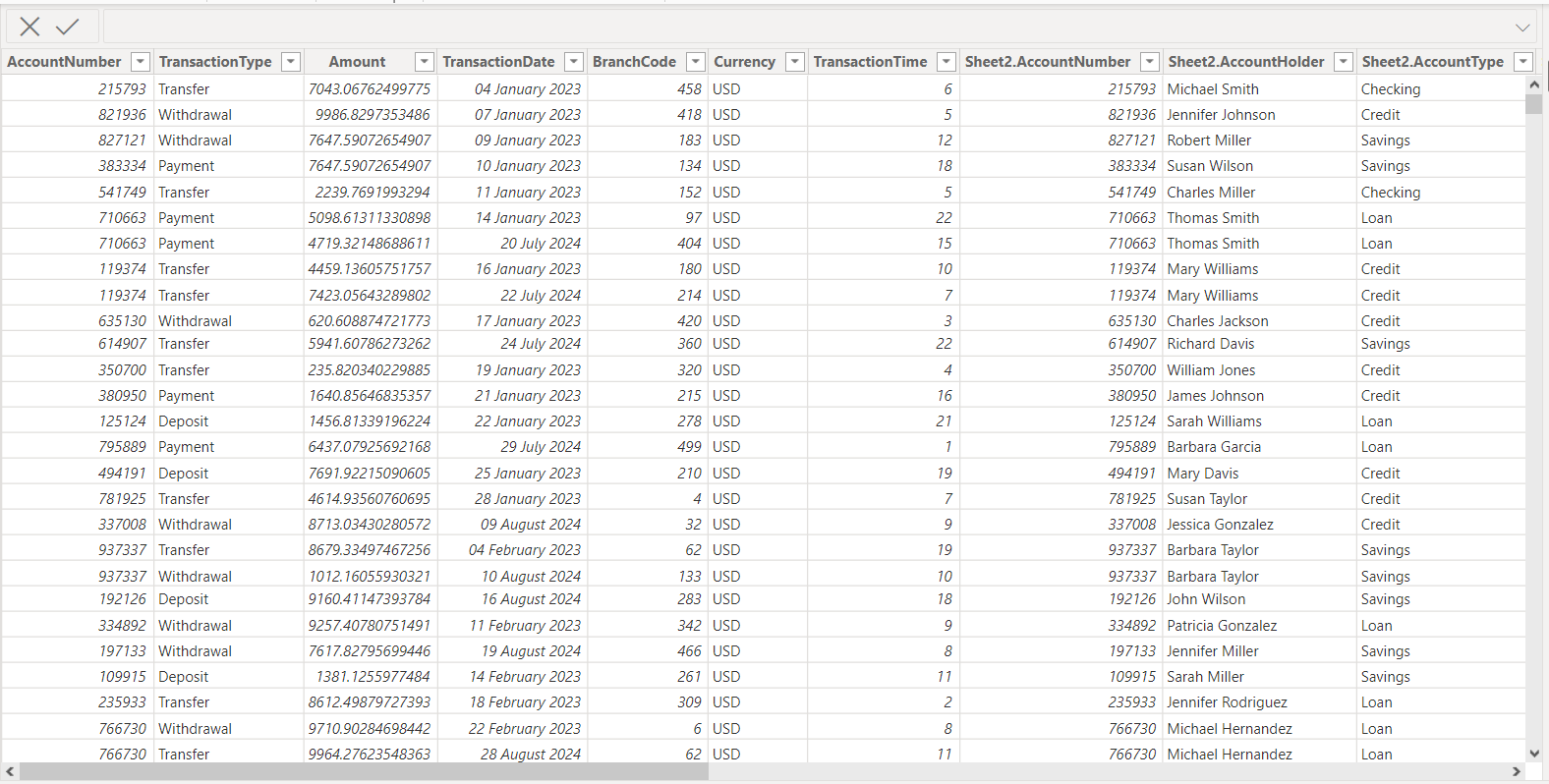
Cleaning: Handling Missing and Irrelevant Data
Identification of Missing Data:
• Carefully reviewed each column in both datasets.
• Used Power Bl's data profiling features to assess completeness.
• Sorted columns by missing values and applied filters to highlight records with missing data.
• Observed missing values in the 'Amount’, ‘TransactionType’ column in the 'Customer Account Details' dataset.
Handling Missing Data:
• Applied strategies based on context:
• For numeric columns like ‘Amount' replaced missing values with zeros.
• For categorical columns like ‘TransactionType' filled missing values using appropriate
techniques (e.g., filling with the mode, most frequent value).
• Encountered challenge in determining imputation threshold.
• Conducted sensitivity analyses to assess impact of different imputation methods.
Handling Irrelevant Data:
• Addressed irrelevant data points:
• Identified columns like 'TransactionlD’.
• Excluded from further analysis as they were not relevant to current objectives.
• Removal streamlined the dataset, focusing analysis on pertinent information.
Before Cleaning
After Cleaning

Slide 4
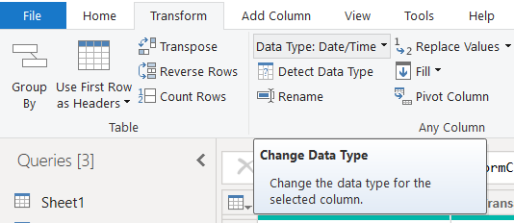
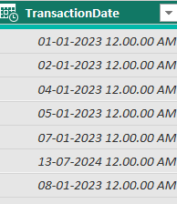
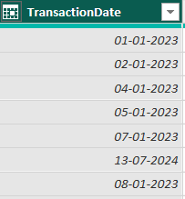
Identification of Data Type Inconsistencies:
• Reviewed data types of each column in both datasets.
• Compared data types against expected types based on dataset descriptions.
• Utilized Power Bl's data profiling features to detect mismatches.
• Observed 'TransactionDate' column imported as mismatched Date/Time instead of date.
Conversion of Data Types:
• Utilized Power Bl's data transformation capabilities.
• Applied transformation to convert 'TransactionDate' from datetime to date.
• Converted numeric columns like 'Amount' and 'Balance' to appropriate numerical types.
• Conversions essential for accurate analysis and visualization.
Data Type Conversion
Before Conversion
After Conversion

Slide 5
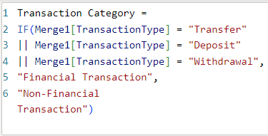
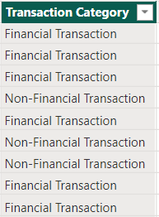
Categorizing Transaction Types
Creation of Transaction Categories:
• Analyzed existing transaction types to create broader categories.
• Grouped transactions into 'Financial Transaction' and 'Non-Financial Transaction’.
• 'Transfer,' 'Deposit,' and 'Withdrawal' categorized as 'Financial Transaction.’
• 'Payment' transactions classified as 'Non-Financial Transaction.'
• Simplifies analysis and provides a clearer understanding of transaction nature.
Implementation in Power BI:
• Created a new calculated column in Power Bl for transaction categorization.
• Used conditional statements to assign transactions to categories.
• Categories based on 'Financial Transaction' or 'Non-Financial Transaction.’
• Facilitates visualization and analysis of transaction trends.
Impact on Analysis:
• Provides insights into transaction nature and customer behaviors.
• 'Financial Transactions' dominate transaction volume, highlighting focus areas.
• Analysis of 'Non-Financial Transactions' reveals customer engagement patterns.
• Guides strategies for enhancing customer experience and satisfaction.

Slide 6
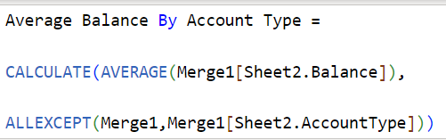
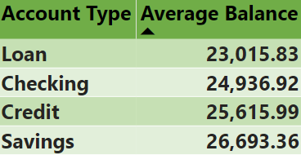
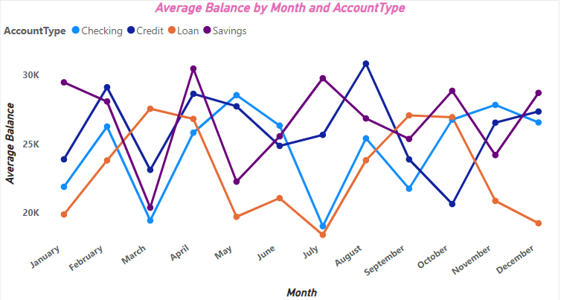
Analysis of Account Balances
Calculation of Average Account Balances:
• Utilized DAX queries in Power Bl for calculation.
• Applied the 'Average Balance By Account Type' DAX query.
• Used AVERAGE function to aggregate balances within each account type.
• Applied ALLEXCEPT function to remove all filters except 'AccountType’
• Provided insights into customer financial behaviors.
Identification of Account Types with Highest Average Balance:
• Found that 'Savings Accounts' had the highest average balance among all account types.
• Attributed the higher average balance of 'Savings Accounts’
to the nature of savings accounts,which typically hold larger balances.
• Recommended targeting investment products and services to customers with higher average balances, such as 'Savings Account' holders.
Visualization of Account Balance Trends:
• Incorporated the calculated average account balances into visualizations within the Power Bl dashboard.
• Developed line charts illustrating trends in account balances over the past year.
• Observed seasonal fluctuations in account balances, with peaks during certain months coinciding with bonus payouts or tax refunds

Slide 7
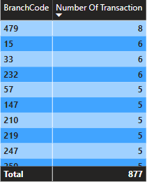
Branch Activity Analysis
Identification of Transaction Branches:
• Examined the 'Branch Code' field in the transaction dataset to identify branches involved in banking transactions.
• Understanding branch activity aids in comprehending banking operations and customer behavior.
• Branches varied significantly in transaction volume, with some handling more transactions than others.
Insights Based on Provided Table:
• Branches with codes 479, 15, 33, and 232 had the highest number of transactions (8, 6, 6, and 6 respectively), indicating their significant activity levels.
• Branches with codes 5, 17, 19, and 20 had the lowest number of transactions (1 each), suggesting relatively lower activity levels.
• Most branches had transaction counts ranging from 1 to 5, with only a few branches having transaction counts exceeding 5, indicating variations in branch activity levels.

Slide 8
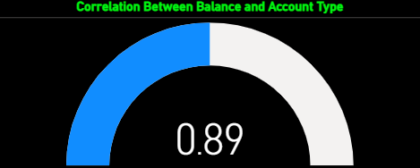
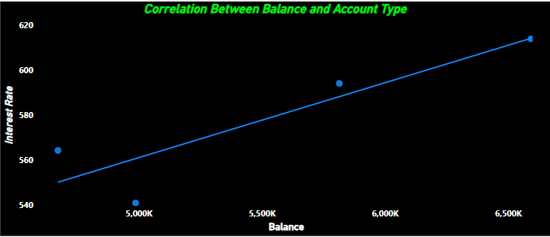
Interest Rate and Balance Correlation Analysis
Calculation of Correlation:
• Utilized Power Bl's quick measure feature to compute the correlation coefficient between interest rates and account balances.
• Applied the built-in correlation quick measure to the interest rate and balance columns in the dataset.
• Obtained a correlation coefficient of 0.89, indicating a strong positive correlation between interest rates and account balances.
• The high correlation coefficient suggests a significant relationship between
interest rates and account balances, implying that changes in interest rates may have a
considerable impact on account balances.
Visualization of Correlation:
• Created a scatter plot visualization in Power Bl to visually represent the correlation between interest rates and account balances.
• Plotted interest rates on the x-axis and account balances on the y-axis, with each data point representing an account.
• The scatter plot visually confirms the strong positive correlation between interest
rates and account balances, with data points clustering closely around a positively sloped
trendline.
Interpretation of Correlation Results:
• Interpreted the correlation coefficient of 0.89 as indicative of a strong positive linear
relationship between interest rates and account balances.
• Concluded that as interest rates increase, account balances tend to increase as well, and vice versa.
• The high correlation underscores the importance of interest rate management in
influencing account balances and guiding banking strategies aimed at maximizing
customer satisfaction and profitability.

Slide 9
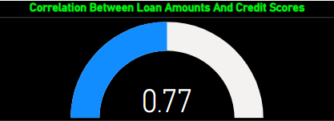
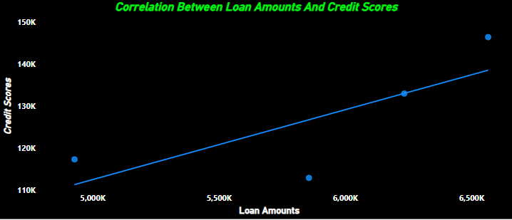
Loan Amount and Credit Score Correlation Analysis
Exploration of Relationship:
• Utilized Quick Measure feature in Power Bl to calculate the correlation coefficient between loan amounts and credit scores.
• Correlation coefficient of 0.77 indicates a strong positive correlation between loan amounts and credit scores.
• This suggests that as credit scores increase, loan amounts also tend to increase, and vice versa.
]
Visualization of Correlation:
• Created a scatter plot visualization in Power Bl to visually represent the correlation between loan amounts and credit scores.
• Plotted loan amounts on the x-axis and credit scores on the y-axis, with each data point representing an account.
• The scatter plot visually confirms the strong positive correlation between loan amounts and credit scores, with data points clustering closely around a positively sloped
trendline.
Interpretation of Analysis Results:
• The strong positive correlation between loan amounts and credit scores implies that customers with higher credit scores are more likely to qualify for larger loan amounts.
• Conversely, customers with lower credit scores may be offered smaller loan amounts or face higher interest rates due to perceived higher risk.
• Understanding this relationship is crucial for risk assessment, loan approval processes, and designing tailored lending products for different customer segments.

Slide 10
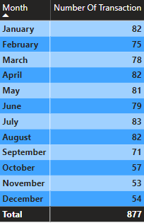
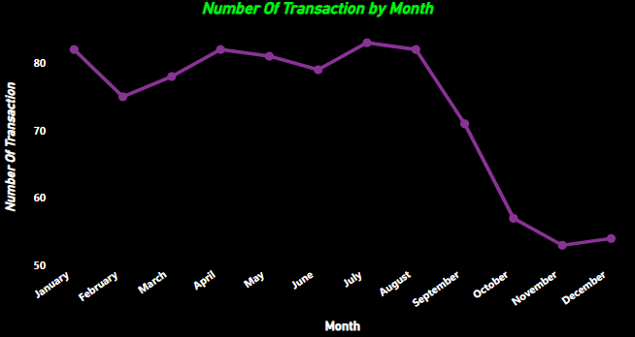
TraNsaction Trends Over Time
Data Examination:
• Utilized Power Bl to analyze transaction trends over a specific time period, typically spanning months or years.
• Imported relevant transaction data into Power Bl and examined the temporal distribution of transactions.
Visualization Techniques:
• Developed line charts or area charts to visualize transaction volumes over time.
• Applied date hierarchies to aggregate transaction data at various levels, such as daily, weekly, or monthly.
Insights from Analysis:
• The transaction volume appears to peak in July, with 83 transactions, and remains consistently high throughout the summer months.
• There is a noticeable decrease in transaction volume towards the end of the year, particularly in November and December, which may coincide with holiday periods or year-end financial planning.
• September has the lowest transaction volume among all the months, indicating a potential seasonal trend or external factors influencing customer behavior.

Slide 11
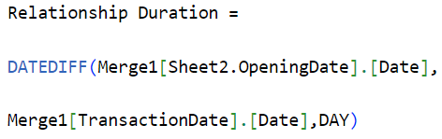
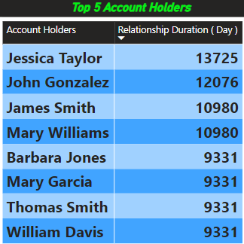
Customer Loyalty Analysis
Creation of Relationship Duration Column:
• Utilized DAX to create a new calculated column named 'Relationship Duration.’
• Implemented the DATEDIFF function to calculate the duration in days between the account opening date and the transaction date.
• The resulting column provides insights into the length of each customer's relationship with the bank.
Calculation Process:
• Applied the DATEDIFF function to subtract the account opening date from the transaction date.
• Specified 'DAY’ as the unit of measurement to calculate the duration in days.
Insights from Analysis:
• Identified Jessica Taylor as the account holder with the longest relationship duration, indicating a strong and enduring relationship with the bank.
• Analyzed the relationship durations of other top account holders to understand patterns and trends in customer loyalty.

Slide 12
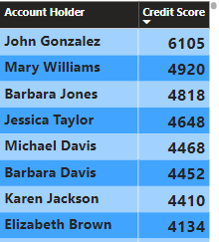
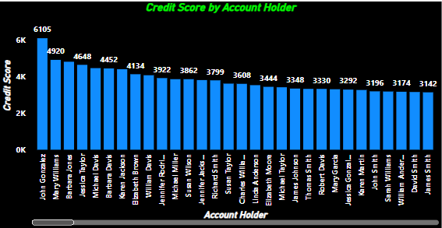
Credit Score Distribution Analysis
Data Exploration for Credit Scores:
• Utilized Power Bl's data import functionality to bring in the dataset containing credit score information.
• Reviewed the distribution of credit scores by examining summary statistics such as mean, median, and standard deviation.
• Understanding the distribution of credit scores provides insights into the overall creditworthiness of account holders and helps identify any potential anomalies or outliers.
Visualization of Credit Score Distribution:
• Created visualizations such as barchart to visualize the distribution of credit scores.
• Applied appropriate bin sizes or grouping intervals to effectively display the distribution while maintaining clarity.
• Visualizing the credit score distribution allows for easy identification of common credit score ranges and outliers, enabling targeted analysis and intervention strategies.
Insights from Analysis:
• John Gonzalez has the highest sum of credit scores among all account holders, indicating a strong credit profile.
• Mary Williams, Barbara Jones, and Jessica Taylor also have relatively high total credit scores, suggesting favorable creditworthiness.
• There is considerable variability in credit scores among account holders, with sums ranging from 345 to 6105

Slide 13
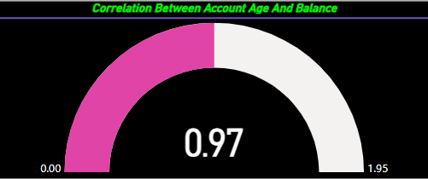
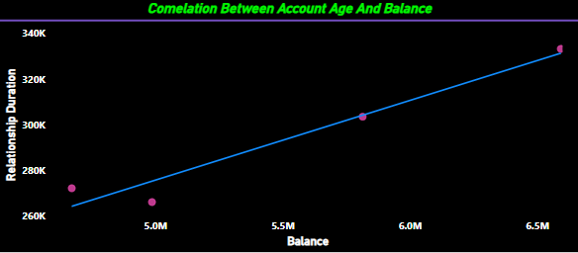
Correlation Between Account Age and Balance
Quick Measure Result:
• Obtained correlation coefficient of 0.97 using the Quick Measure feature.
• Interpreted the result as a strong positive correlation between account age and balance.
• Quick Measure provided an efficient way to analyze correlation without manually creating DAX formulas.
Visualization of Correlation:
• Visualized correlation using scatter plot with account age on x-axis and balance on y-axis.
• Incorporated trend lines or regression analysis to visualize correlation strength.
• Identified any outliers or patterns in the data.
Analysis of Correlation Results:
• Analyzed correlation coefficient to determine strength and direction of correlation.
• Quick Measure result (correlation coefficient of 0.97) indicates a strong positive correlation between account age and balance.
• Correlation analysis suggests that older accounts tend to have higher balances, indicating potential for targeted marketing or product offerings.

Slide 14


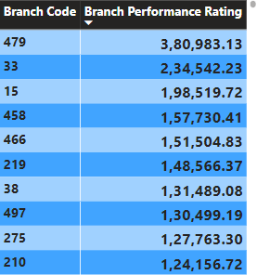
Performance Rating of Branches
Calculate Transaction Volume by Branch:
• Used Power Bl's modeling capabilities to create a new measure that calculates the total number of transactions for each branch.
• This measure counts the total number of rows (transactions) in the table.
Calculate Transaction Value by Branch:
• Similarly, create another measure to calculate the total transaction value for each branch.
• This measure sums up the 'Amount' column in the table to get the total transaction value.
Create a Performance Rating Measure:
• Combine the transaction volume and value measures to create a performance rating measure for branches.
• This measure multiplies the transaction volume by the transaction value to obtain a performance rating for each branch.
Insights from Analysis:
• Branches with the highest performance ratings, such as Branch Code 479, 33, and 15,demonstrate both high transaction volume and value. These branches are likely effectively serving customers and generating significant revenue for the bank.
• Conversely, branches with lower performance ratings, like Branch Code 426, 429, and 435, may require closer examination to understand why their transaction volume and value are comparatively lower. Potential factors contributing to this could include geographic location,

Slide 15
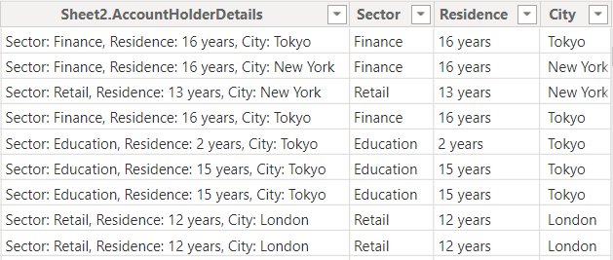
Extracting Key Information
Data Extraction Process:
• Utilized Power Bl's data transformation capabilities to extract key information from the 'AccountHolderDetails' column.
• Employed string manipulation functions to parse the 'AccountHolderDetails' column and extract relevant information such as employment sector, years at current residence, and city of residence.
• Used techniques such as splitting, substring extraction, or pattern matching to extract specific details from the unstructured 'AccountHolderDetails' column.
Creation of New Columns:
• Created new columns in the dataset to store the extracted key information separately for easier analysis.
• Ensured that each extracted piece of information (e.g., employment sector, years at current residence, city of residence) was stored in its own separate column for clarity and consistency.
• Applied appropriate data types and formatting to the new columns to ensure compatibility with subsequent analysis.

Slide 16
